Slide 1
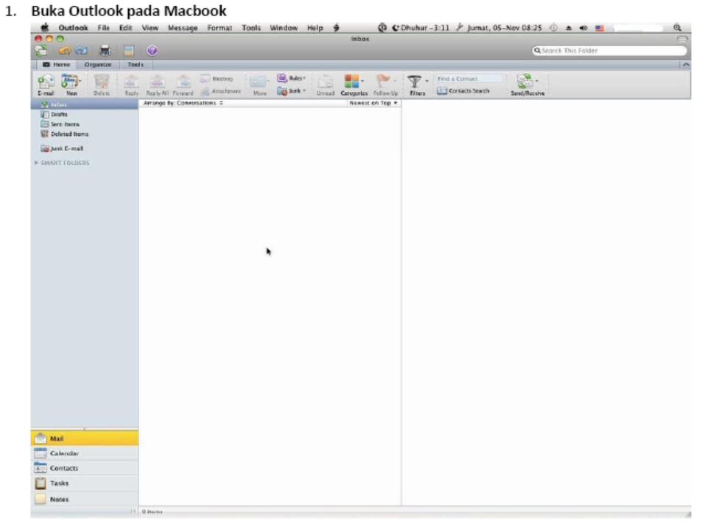
Email – Setting Konfigurasi Email - MacBook

Slide 2
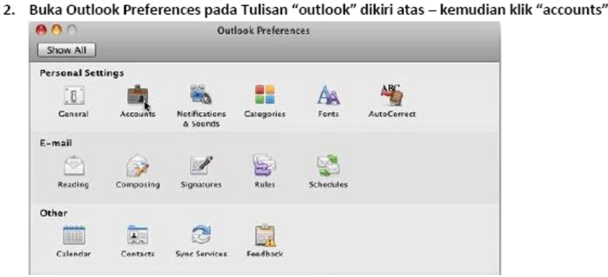
Email – Setting Konfigurasi Email - MacBook

Slide 3
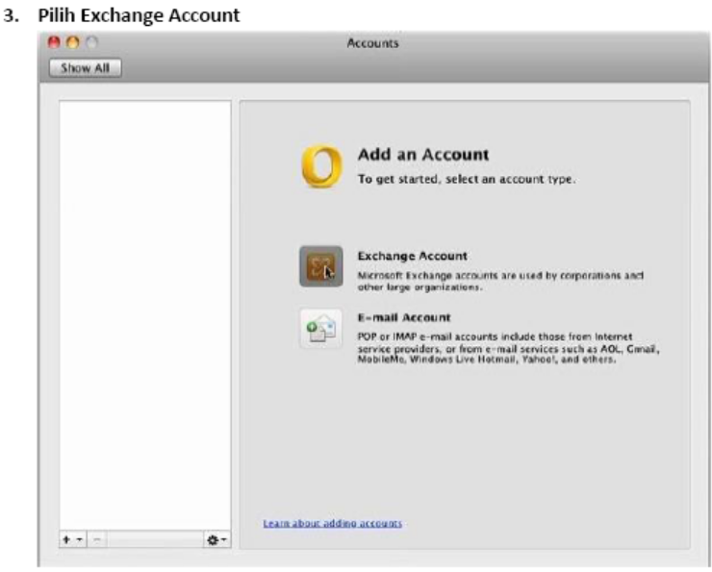
Email – Setting Konfigurasi Email - MacBook

Slide 4
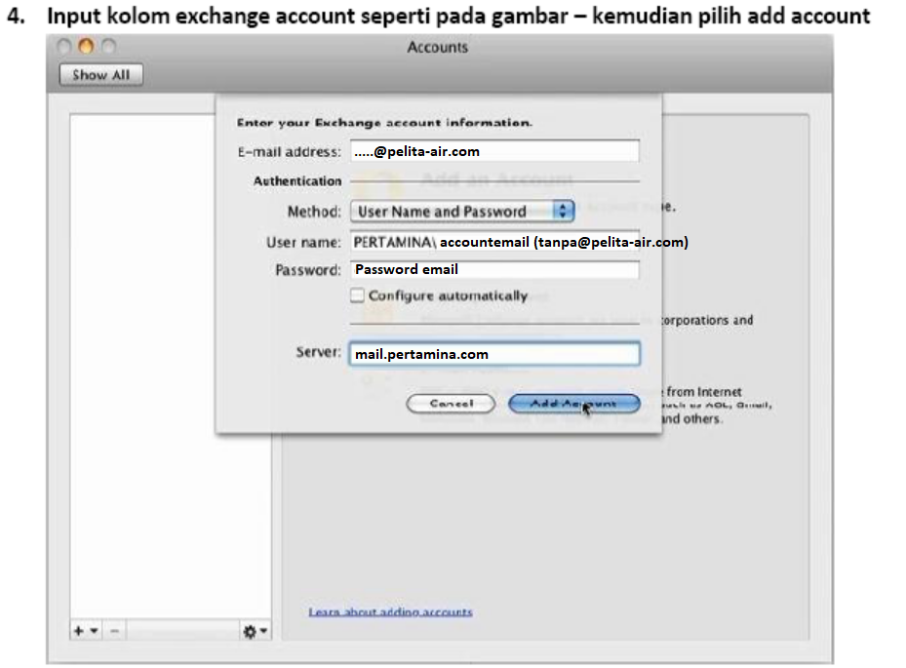
Email – Setting Konfigurasi Email - MacBook

Slide 5
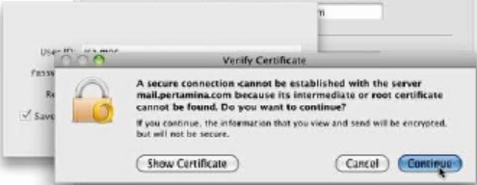
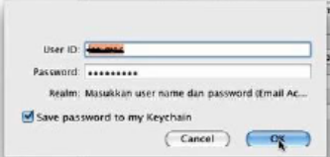
Email – Setting Konfigurasi Email - MacBook

Slide 6
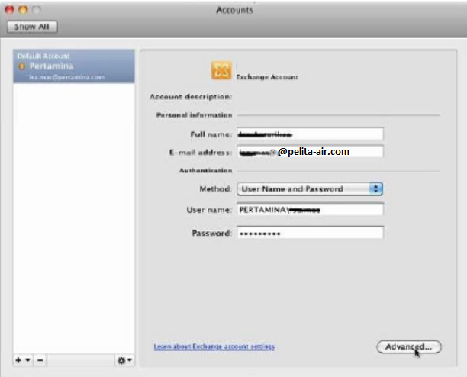
Email – Setting Konfigurasi Email - MacBook

Slide 7
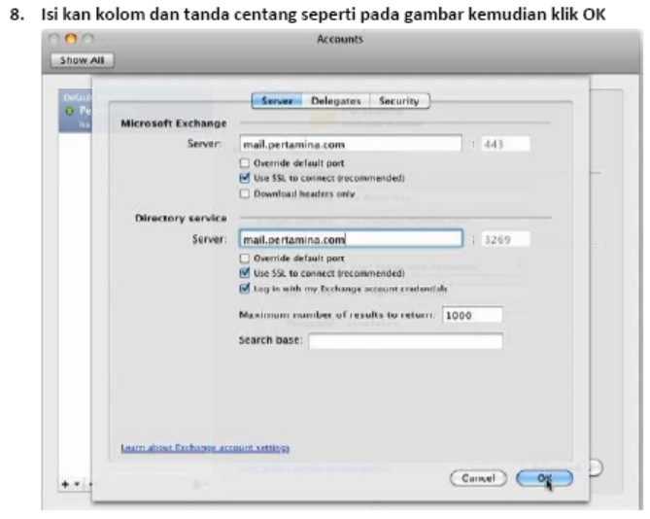
Email – Setting Konfigurasi Email - MacBook

Slide 8
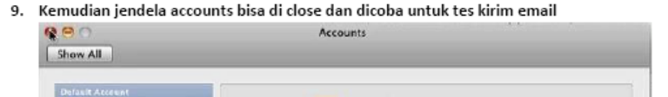
Email – Setting Konfigurasi Email - MacBook

